Slide 1
Atomic Structure and the Periodic Table Lesson 1
Atoms, Elements and Isotopes

Slide 2
Learning Objective
To understand the structure of atoms, elements and isotopes.
Targeting Assessment Objectives AO1 and AO2
Success Criteria
To define the terms atoms, element and isotopes.
To describe the structure of atoms.
To use information about isotopes to calculate the relative atomic mass.

Slide 3

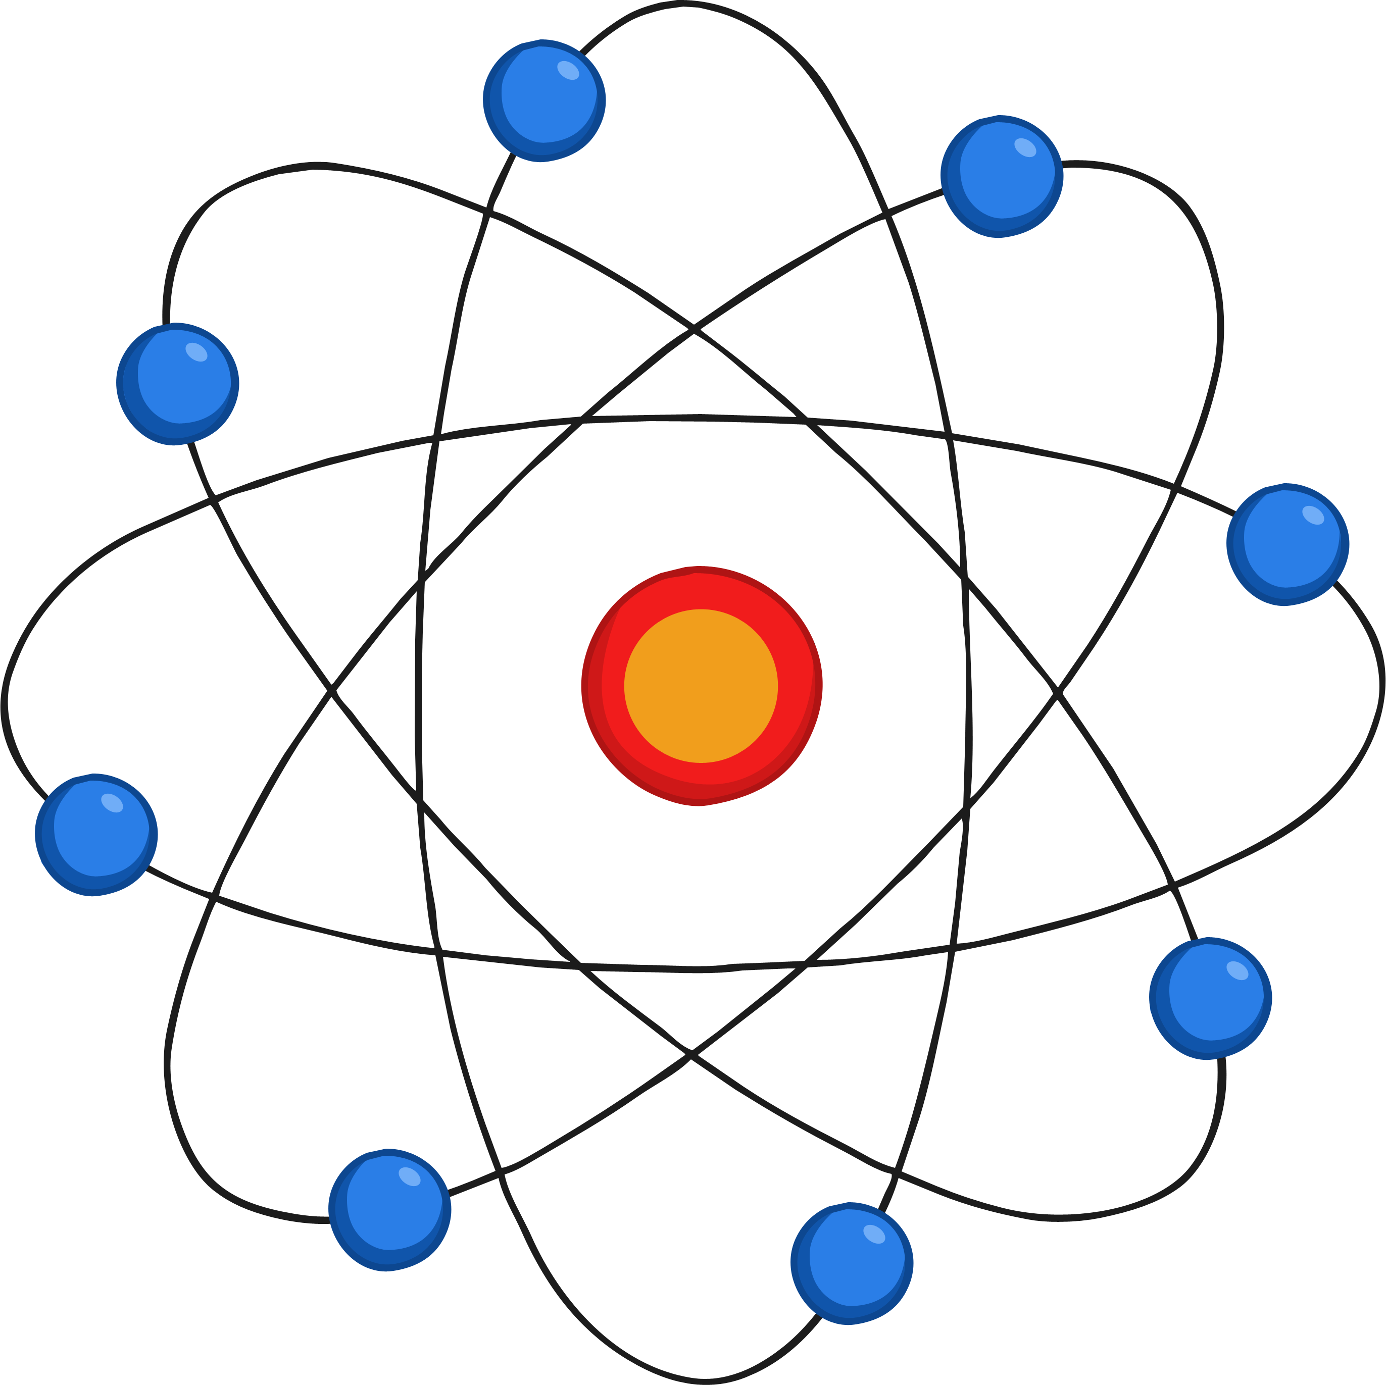
What Am I?
I have a radius of 0.1 nanometres.
I am made up of protons, neutrons and electrons.
I have a nucleus.
I have no overall charge.
My nucleus has a positive charge.
atom

Slide 4
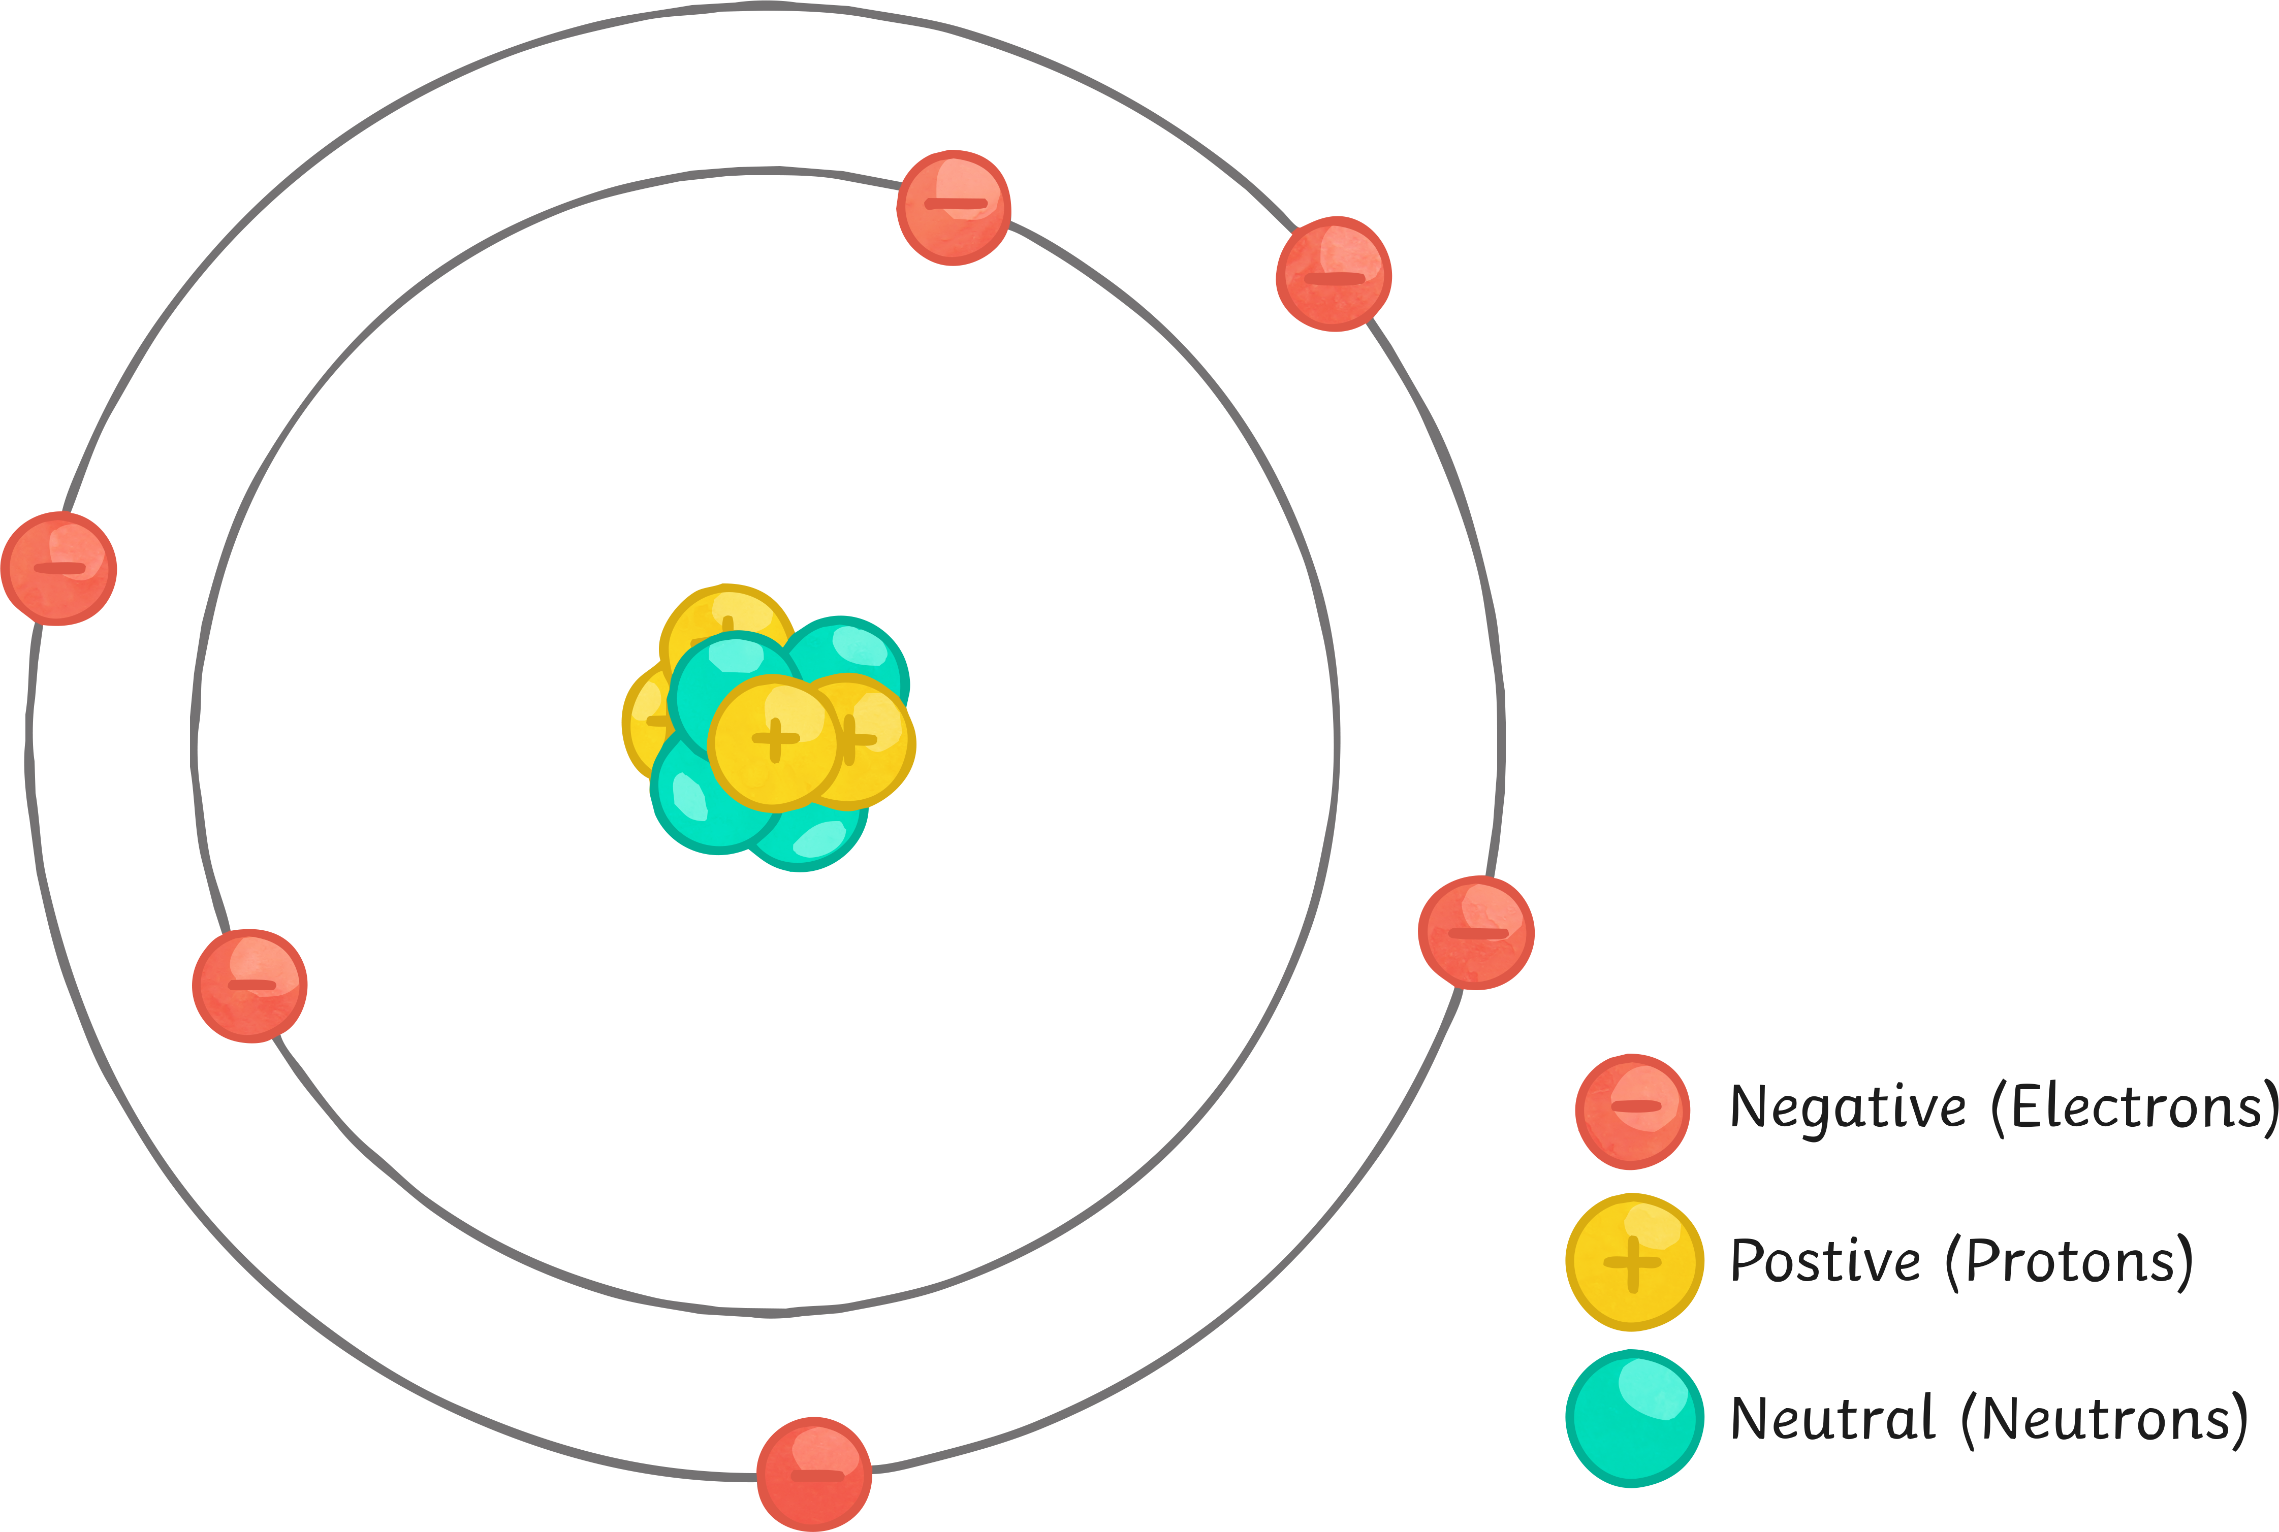

Atoms: What Do You Know?
Can you label the diagram of the atom?
Key Terms
nucleus
proton
neutron
electron
Extension: Can you state the charges of the subatomic particles?

Slide 5
Answers

Slide 6

The Atom: Some Facts
Atoms are neutral. They have no overall charge because the number of protons and electrons are the same.
Particle | Relative Mass | Relative Charge
proton | 1 | +1
neutron | 1 | 0
electron | very small | -1
Atoms have a radius of 0.1 nanometers.

Slide 7
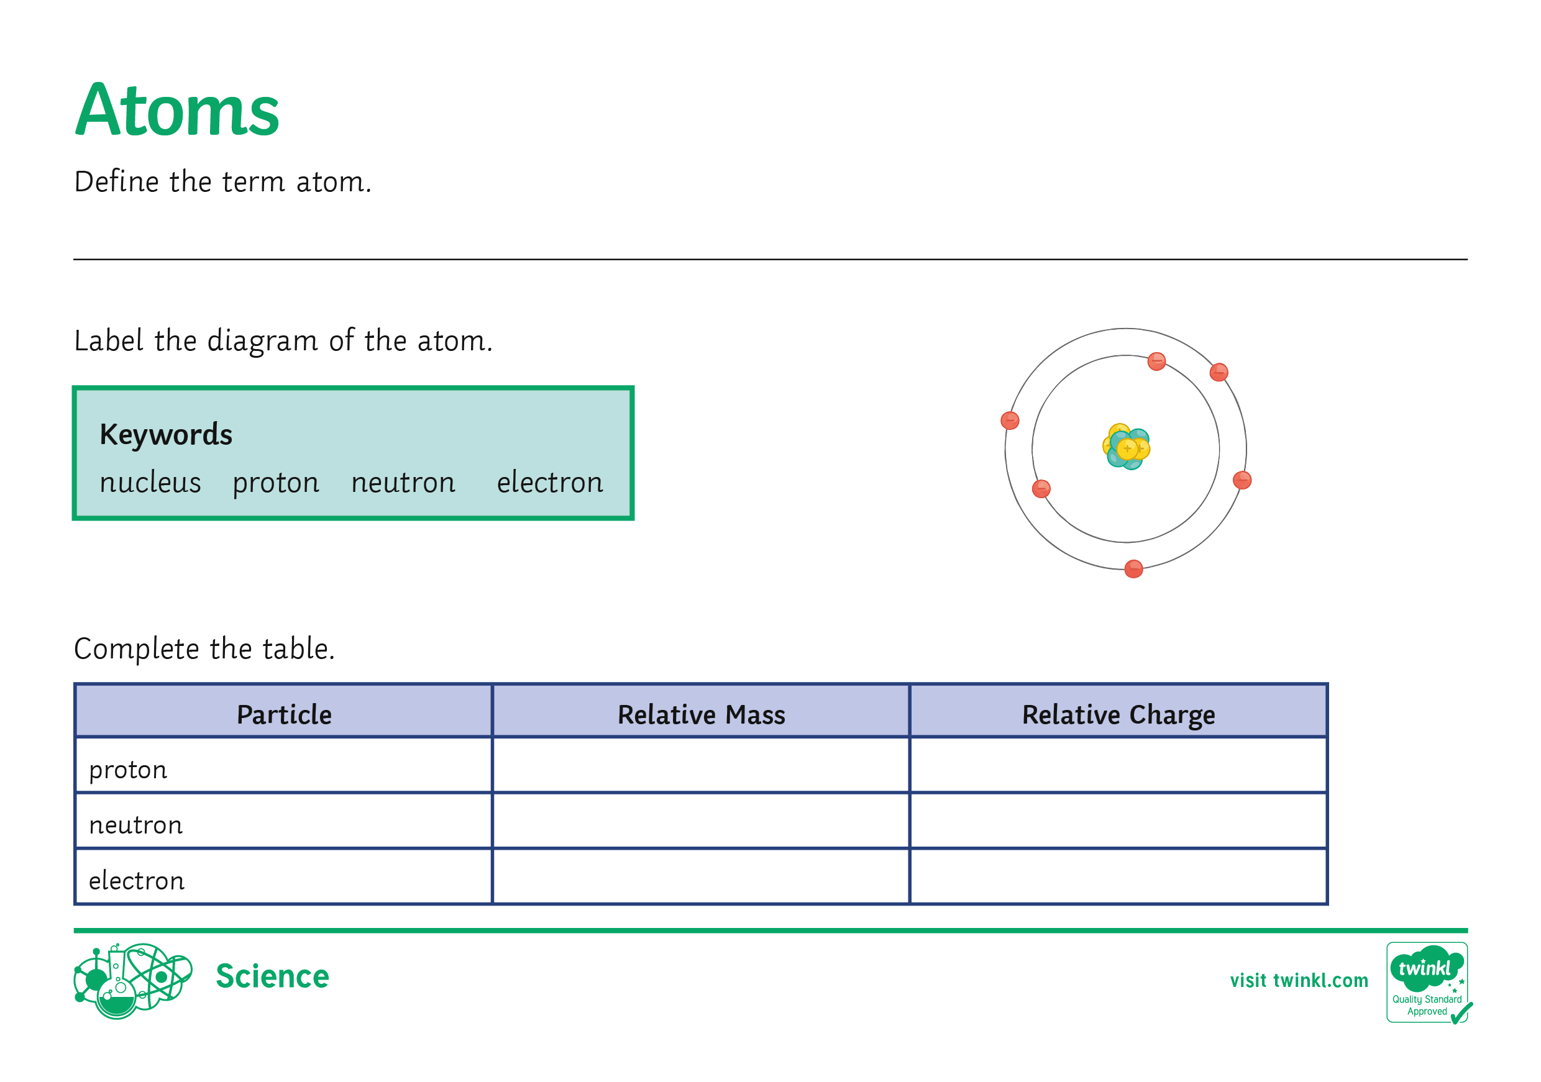
Atoms
On your activity sheet, define the term atom.
Label the diagram of the atom.
Complete the table showing
the particle’s mass and charge.

Slide 8
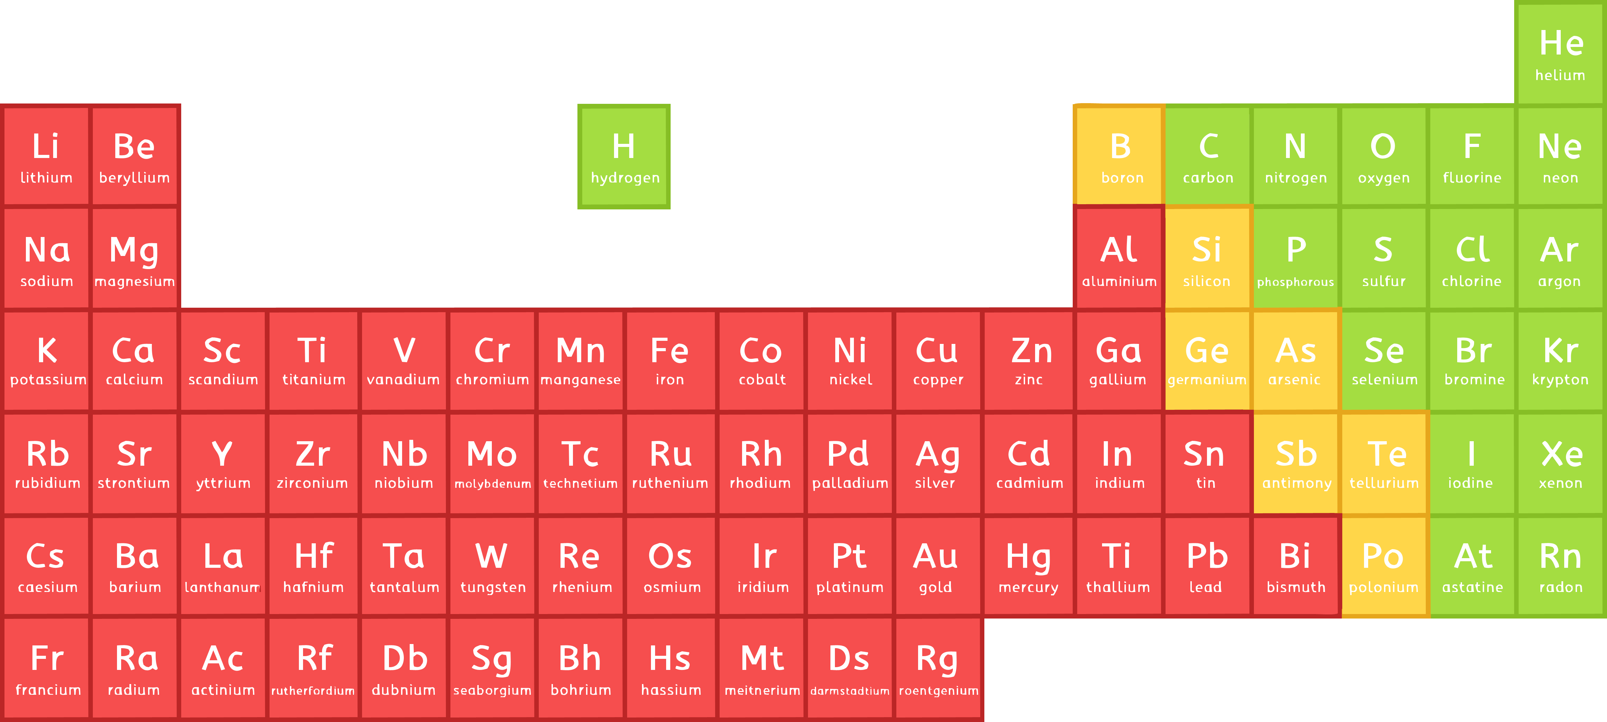
Elements
Elements are made of one type of atom only.
They are represented by both a name and a symbol. For example,
carbon = C and sodium = Na (notice how the first letter is always shown by a capital and the second is lower case).
Elements can be found on the periodic table; there are over 100 of them.

Slide 9

Elements
Look at your copy of the periodic table. Apart from the element name and symbol, what else do you notice?
16
Mass Number
O
Atomic Number
8
The atomic number is the number of protons each atom contains.
The mass number is the total number of protons and neutrons in the atom.

Slide 10
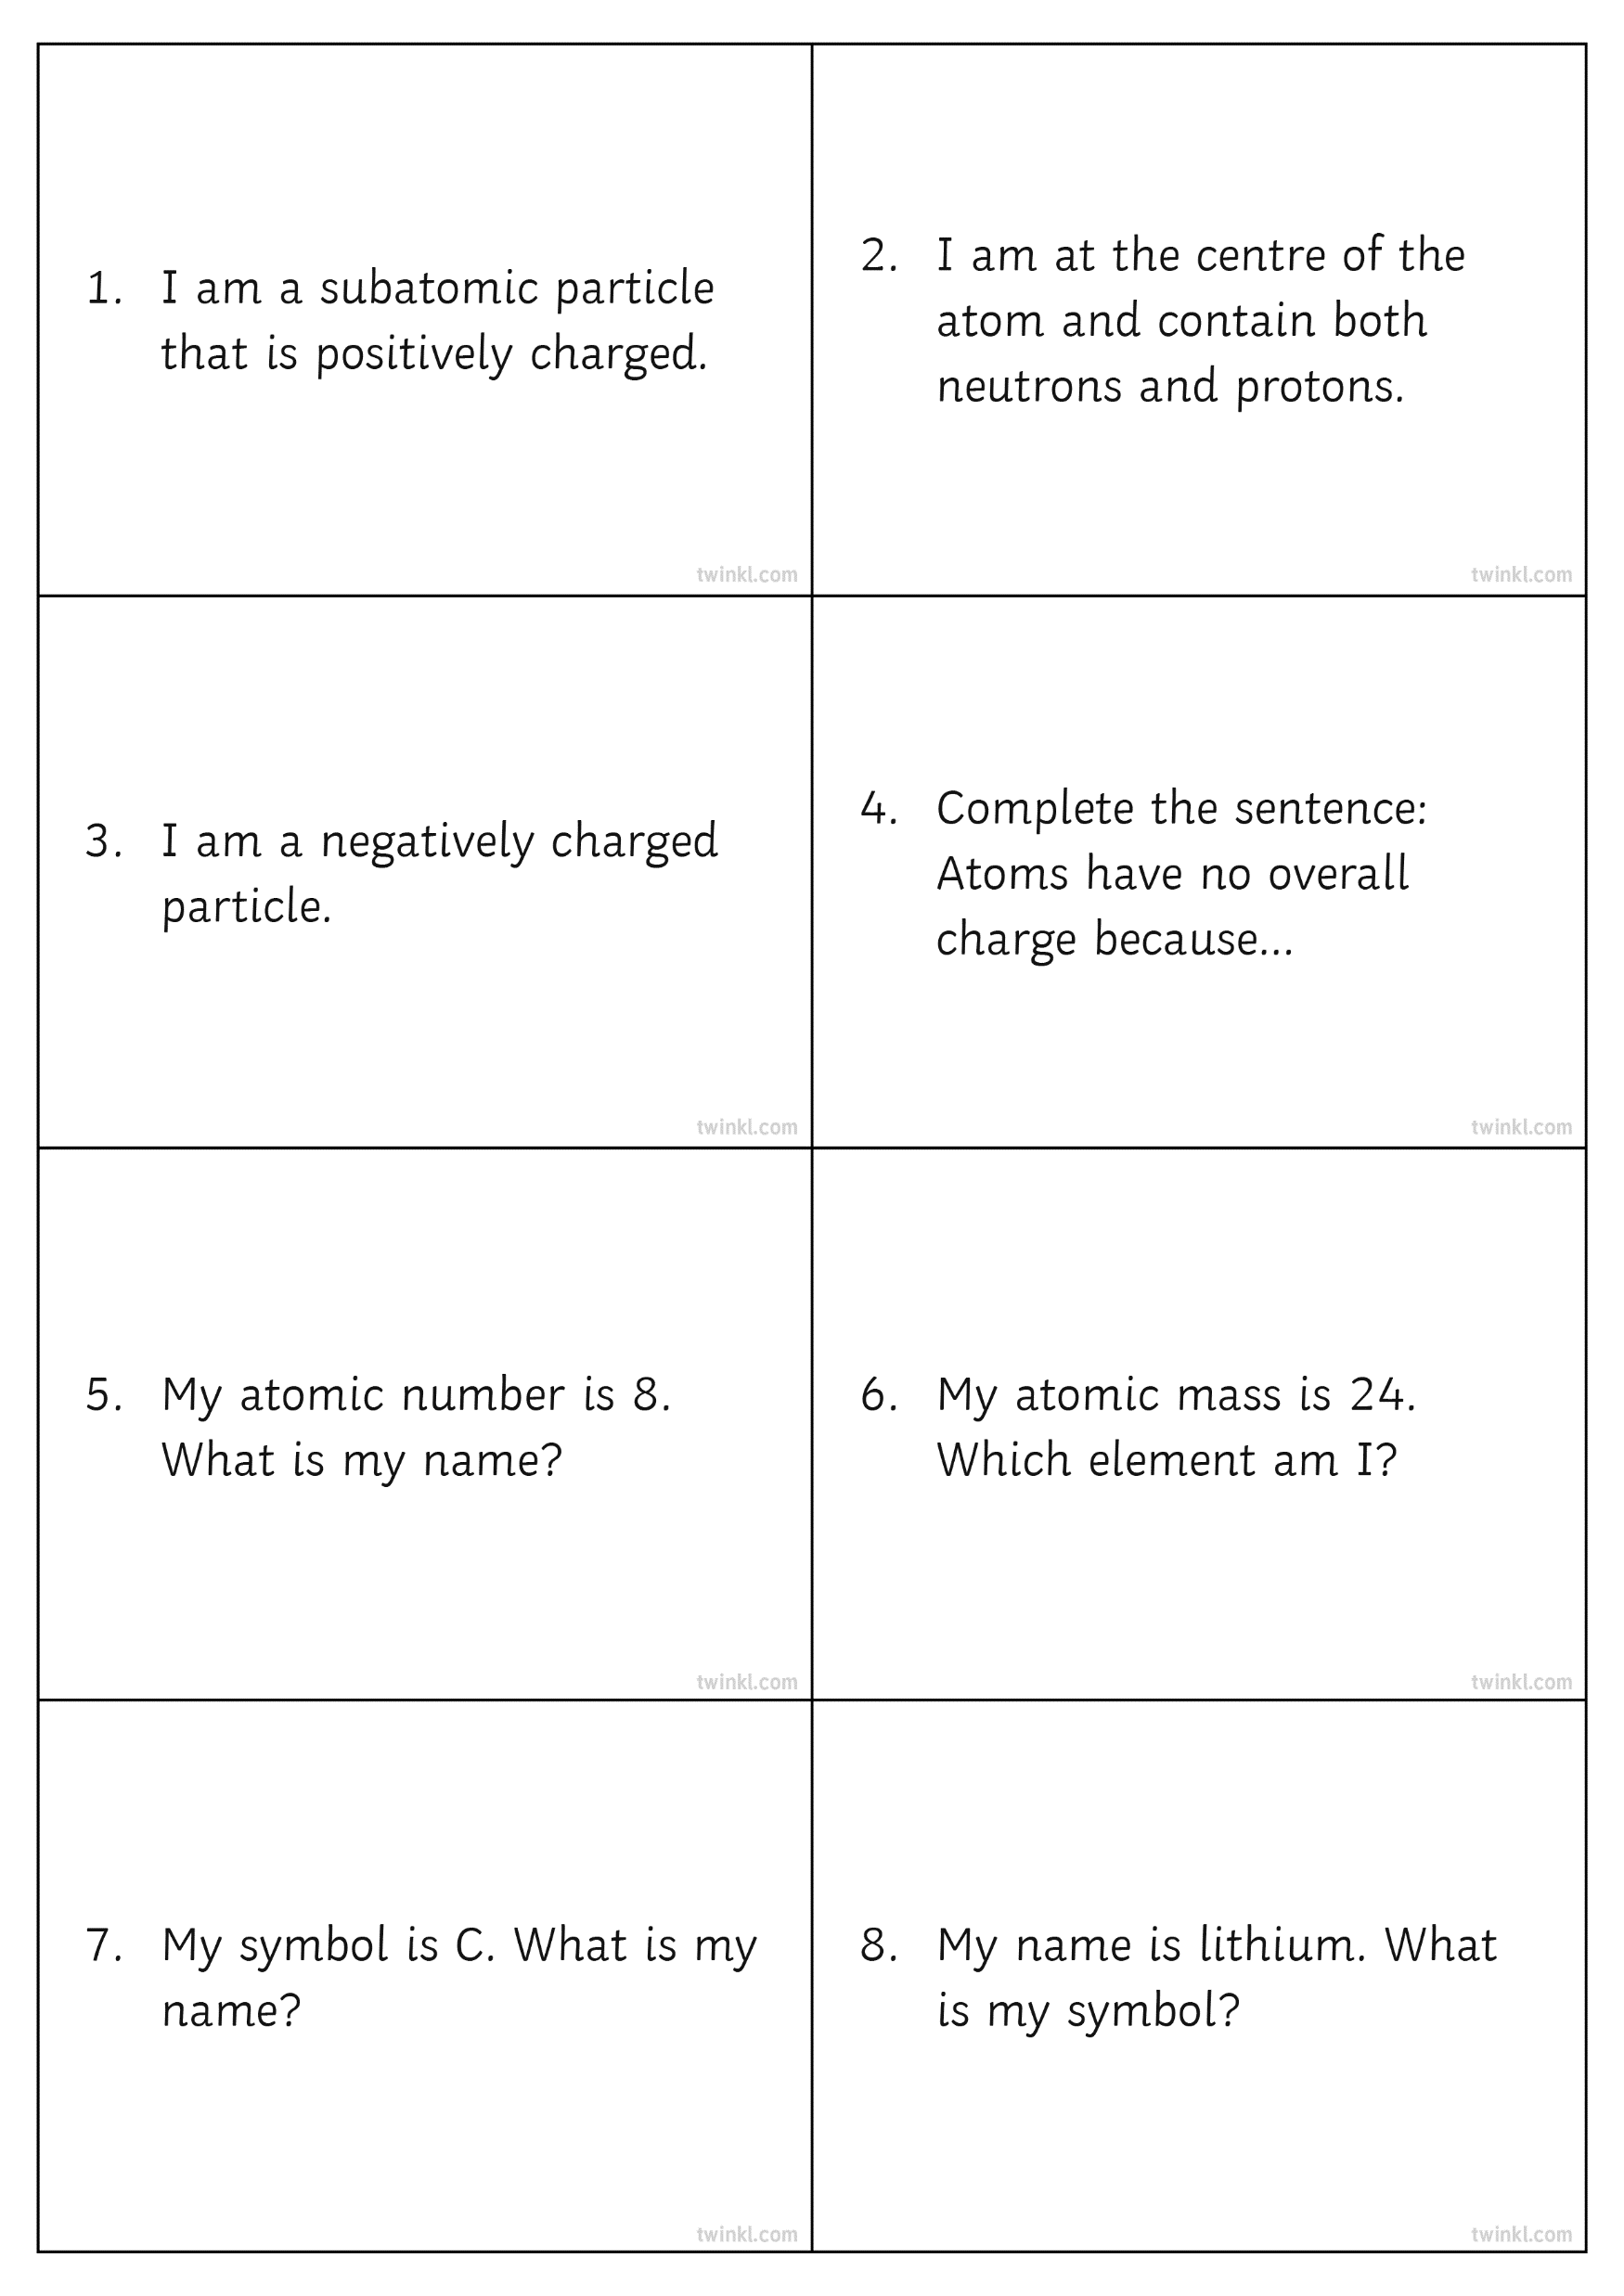
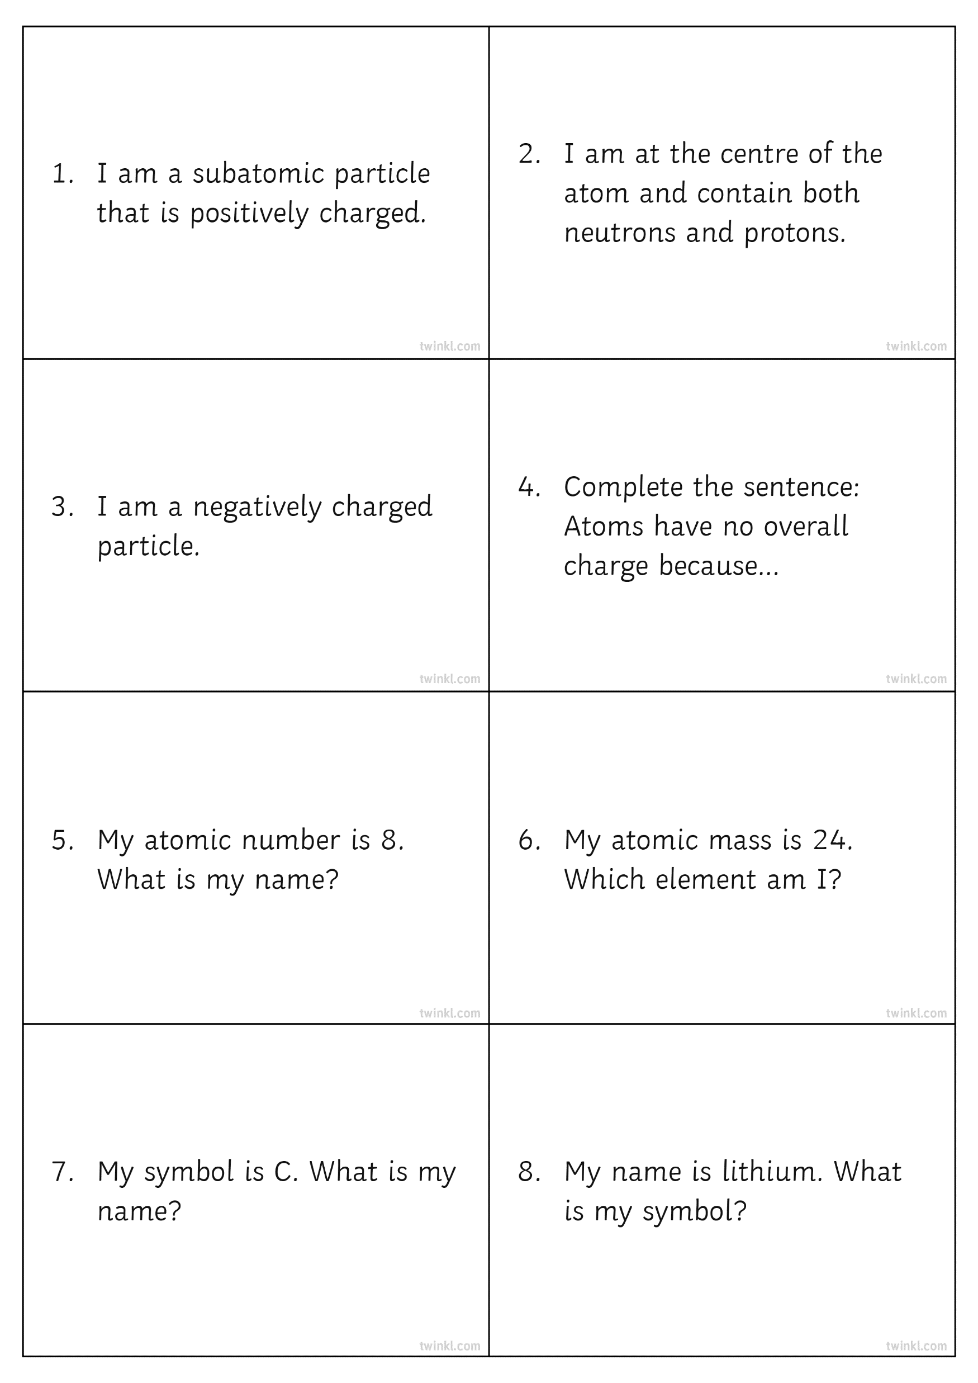
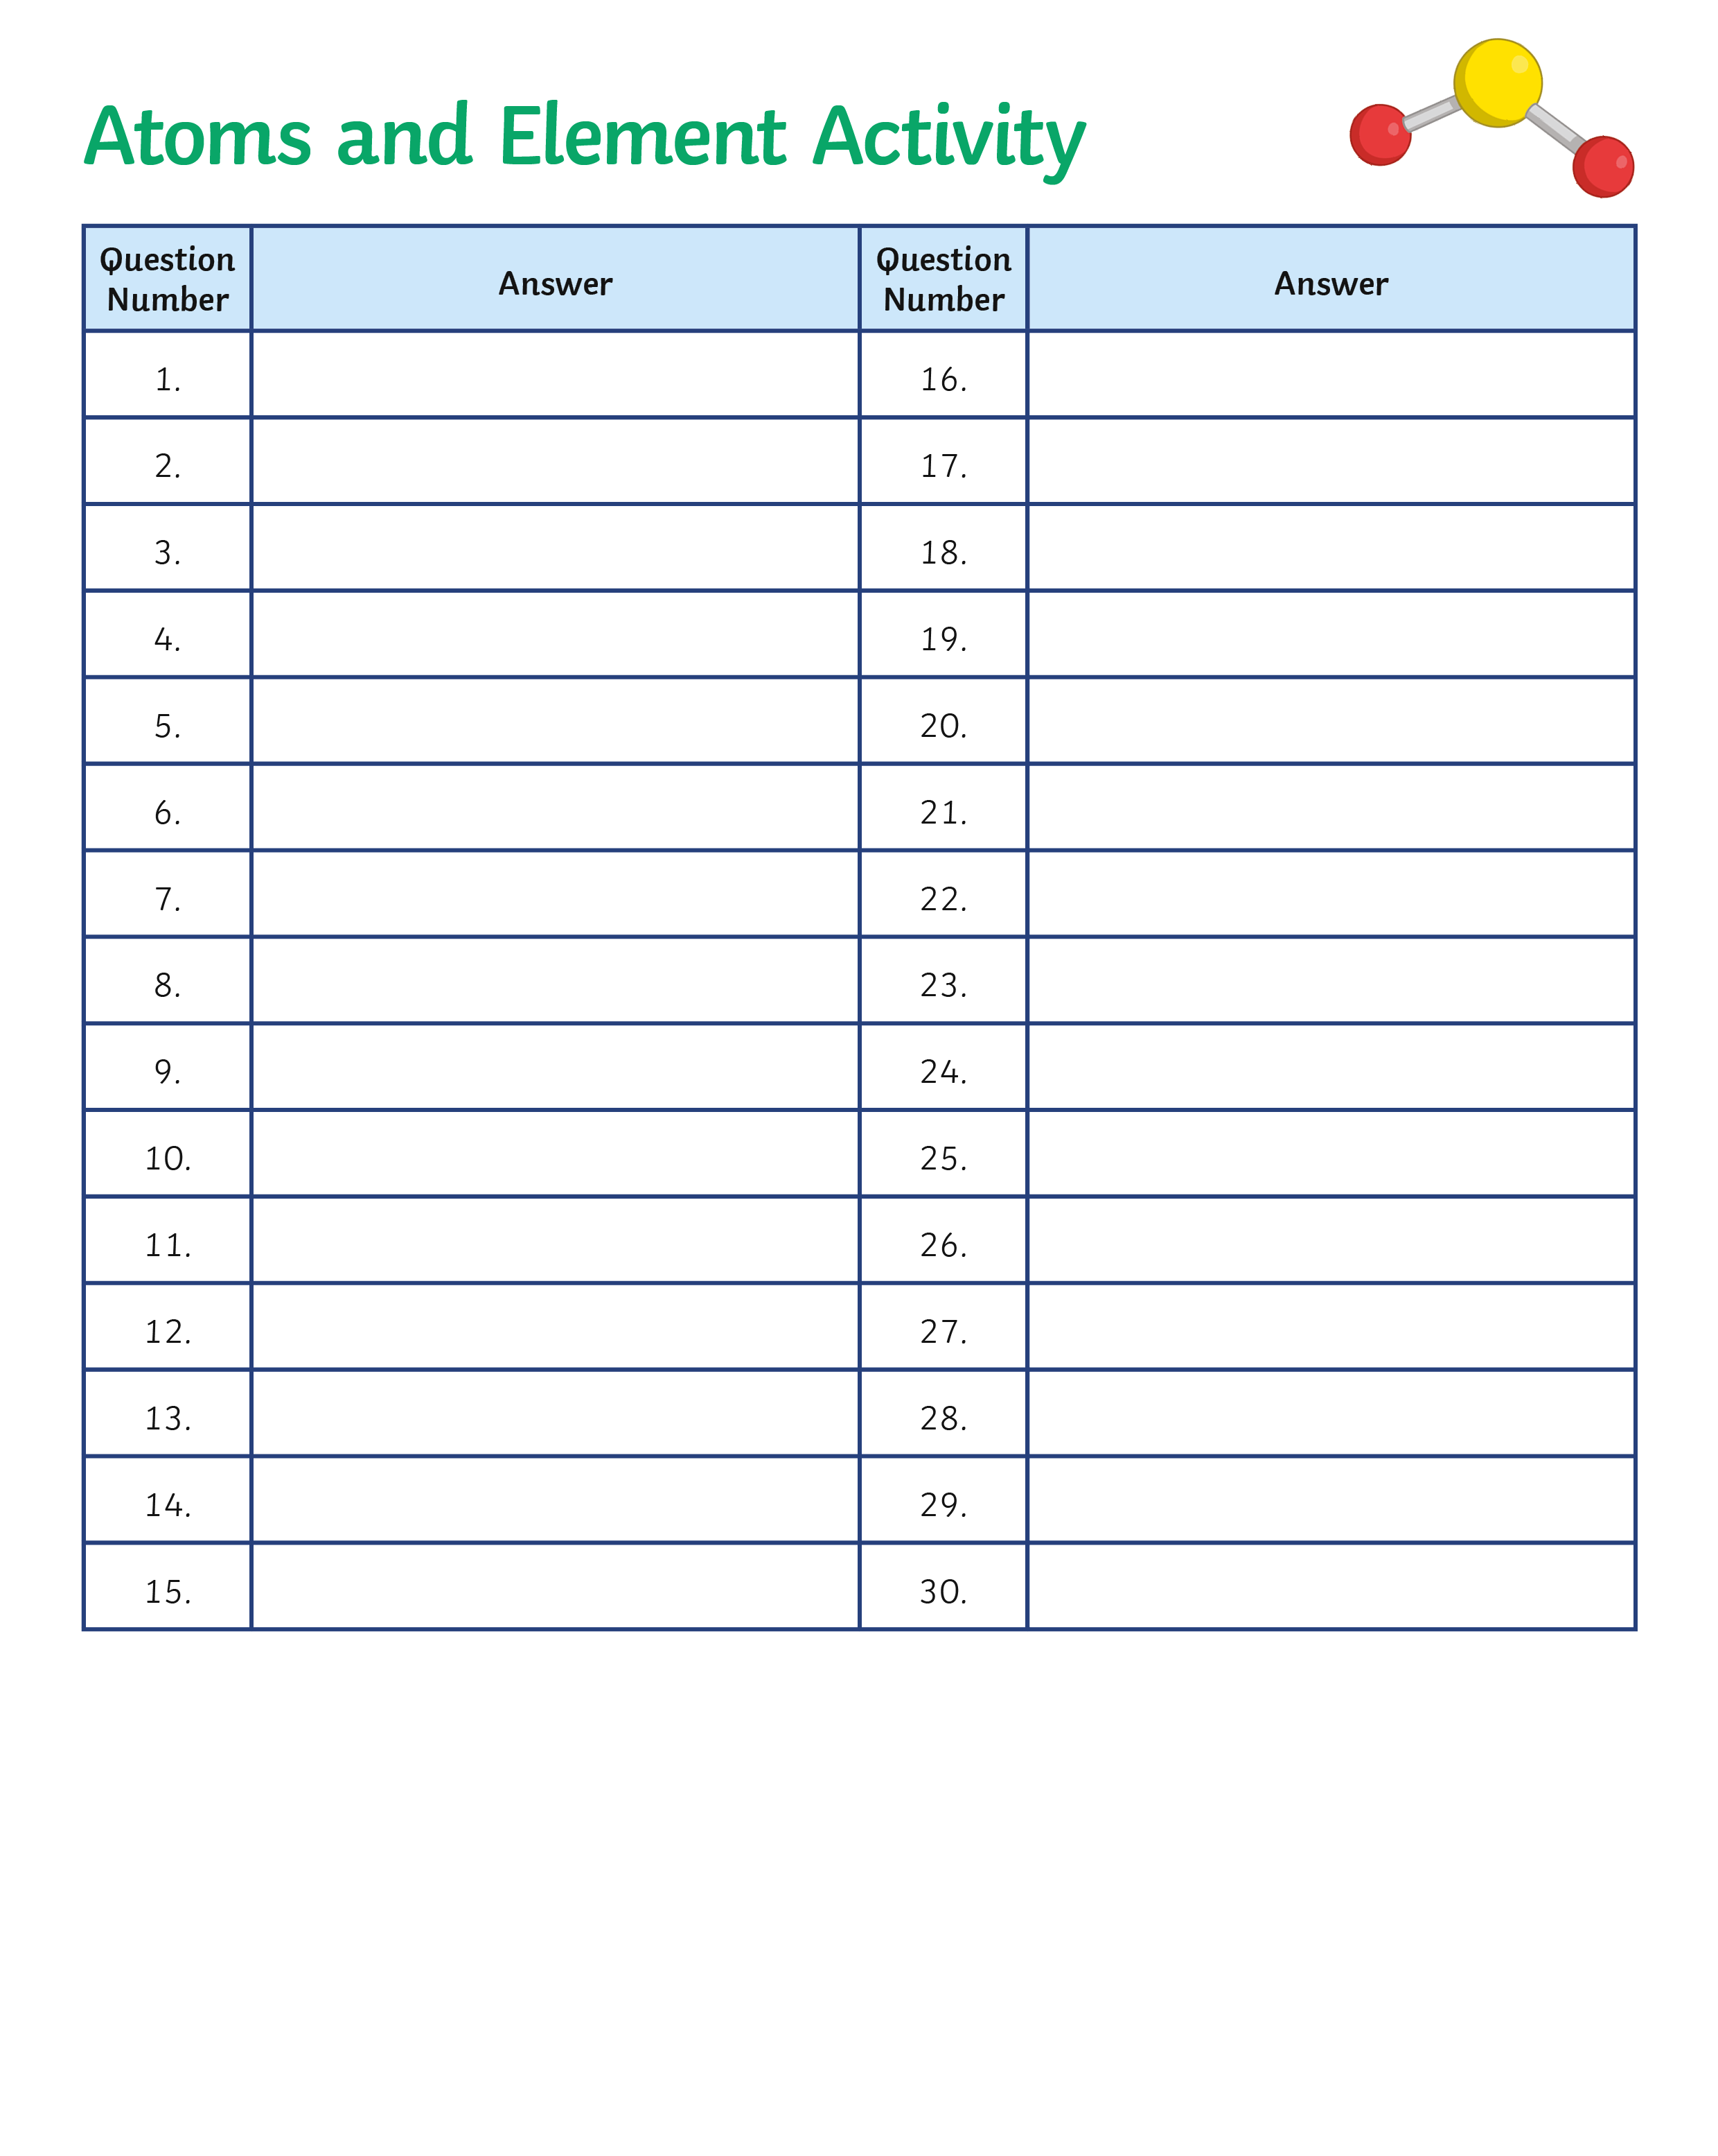
Atoms and Elements
Each person will be given a card with a question on it. Each card also has a question number.
Read your question and record your answer on the answer sheet next to the appropriate number.
Move around the room swapping question cards with other pupils. Each time you swap a card, read the question and record your answer.
There are 30 questions in total.
How many can you complete in 10 minutes?

Slide 11
Atoms and Elements: Example
proton

Slide 12
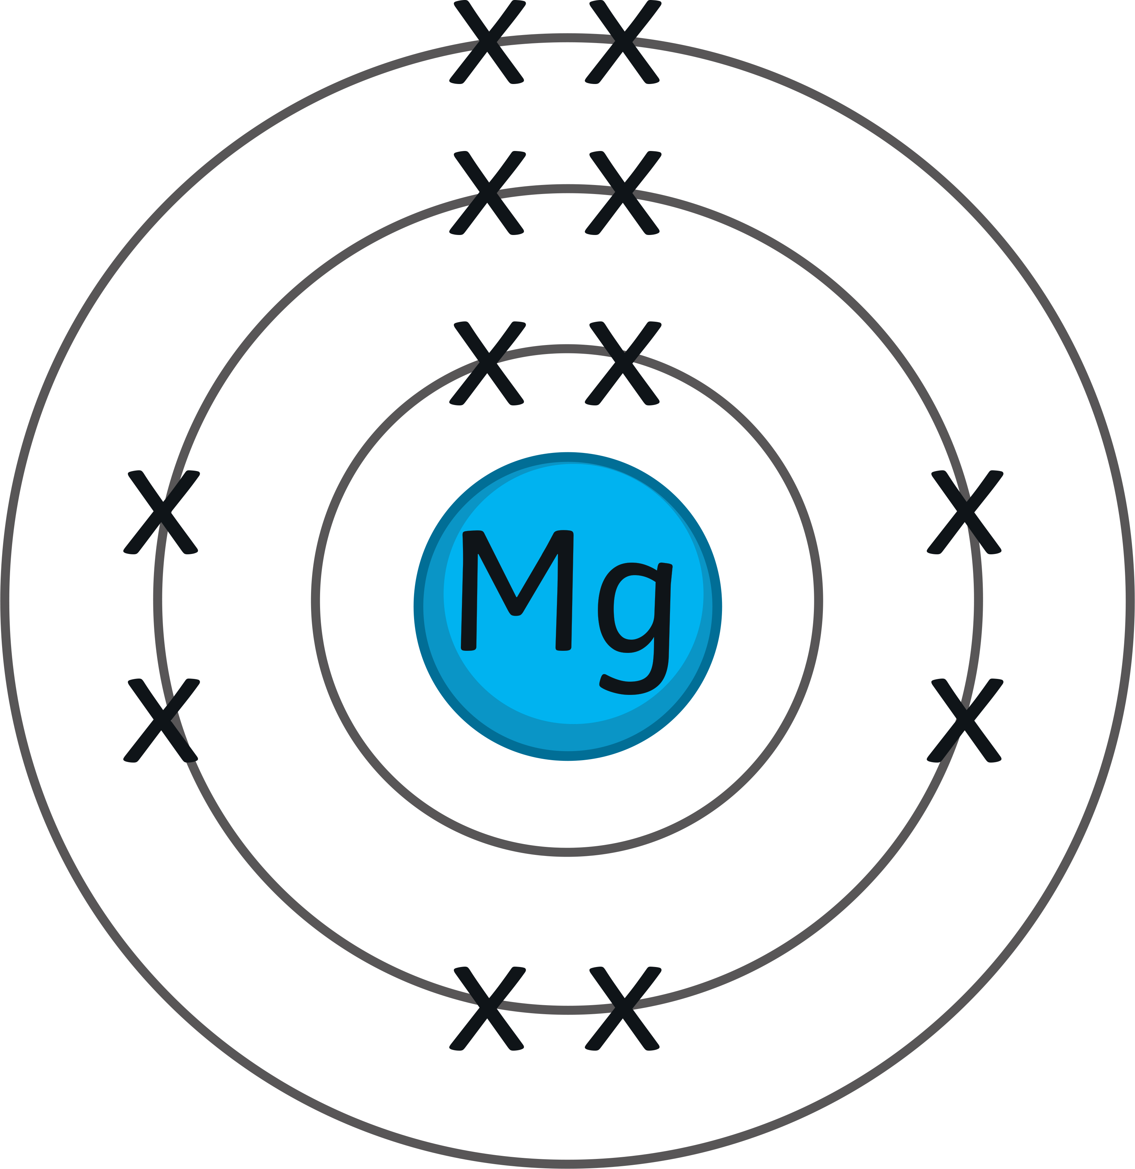

Quick Assessment: Exam Question
Magnesium is in group 2 and period 3 of the periodic table. Here is a diagram of a magnesium atom.
What is the mass number of a magnesium atom?
What is the charge of a proton?
Protons are found in the nucleus. Which other subatomic particle is found in the nucleus?
Which particle number is always different for atoms of different elements?
The diagram shows the electron arrangement for an element.
Give the chemical symbol of the element.

Slide 13
Answers
Magnesium is in group 2 and period 3 of the periodic table. Here is a diagram of a magnesium atom.
What is the mass number of a magnesium atom?
What is the charge of a proton?
Protons are found in the nucleus. Which other subatomic particle is found in the nucleus?
Which particle number is always different for atoms of different elements?
24
positive
neutrons
number of protons
The diagram shows the electron arrangement for an element.
Give the chemical symbol of the element.
N

Slide 14


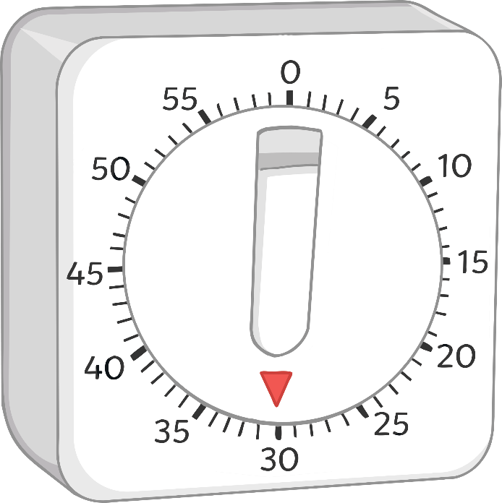

The First 20 Elements: How Many Can You Name?
You have one minute to study the name and symbol of the first 20 elements.
Start

Slide 15
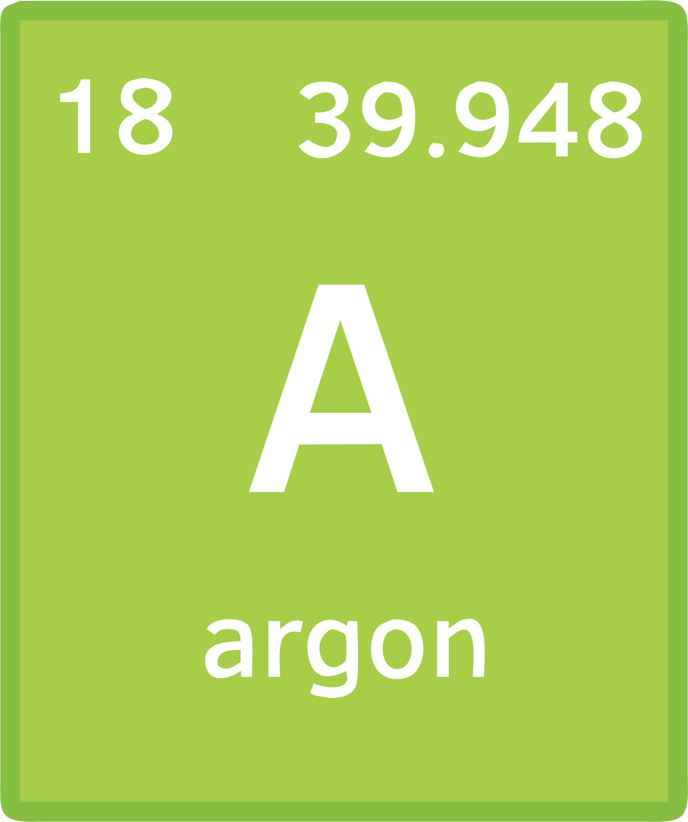
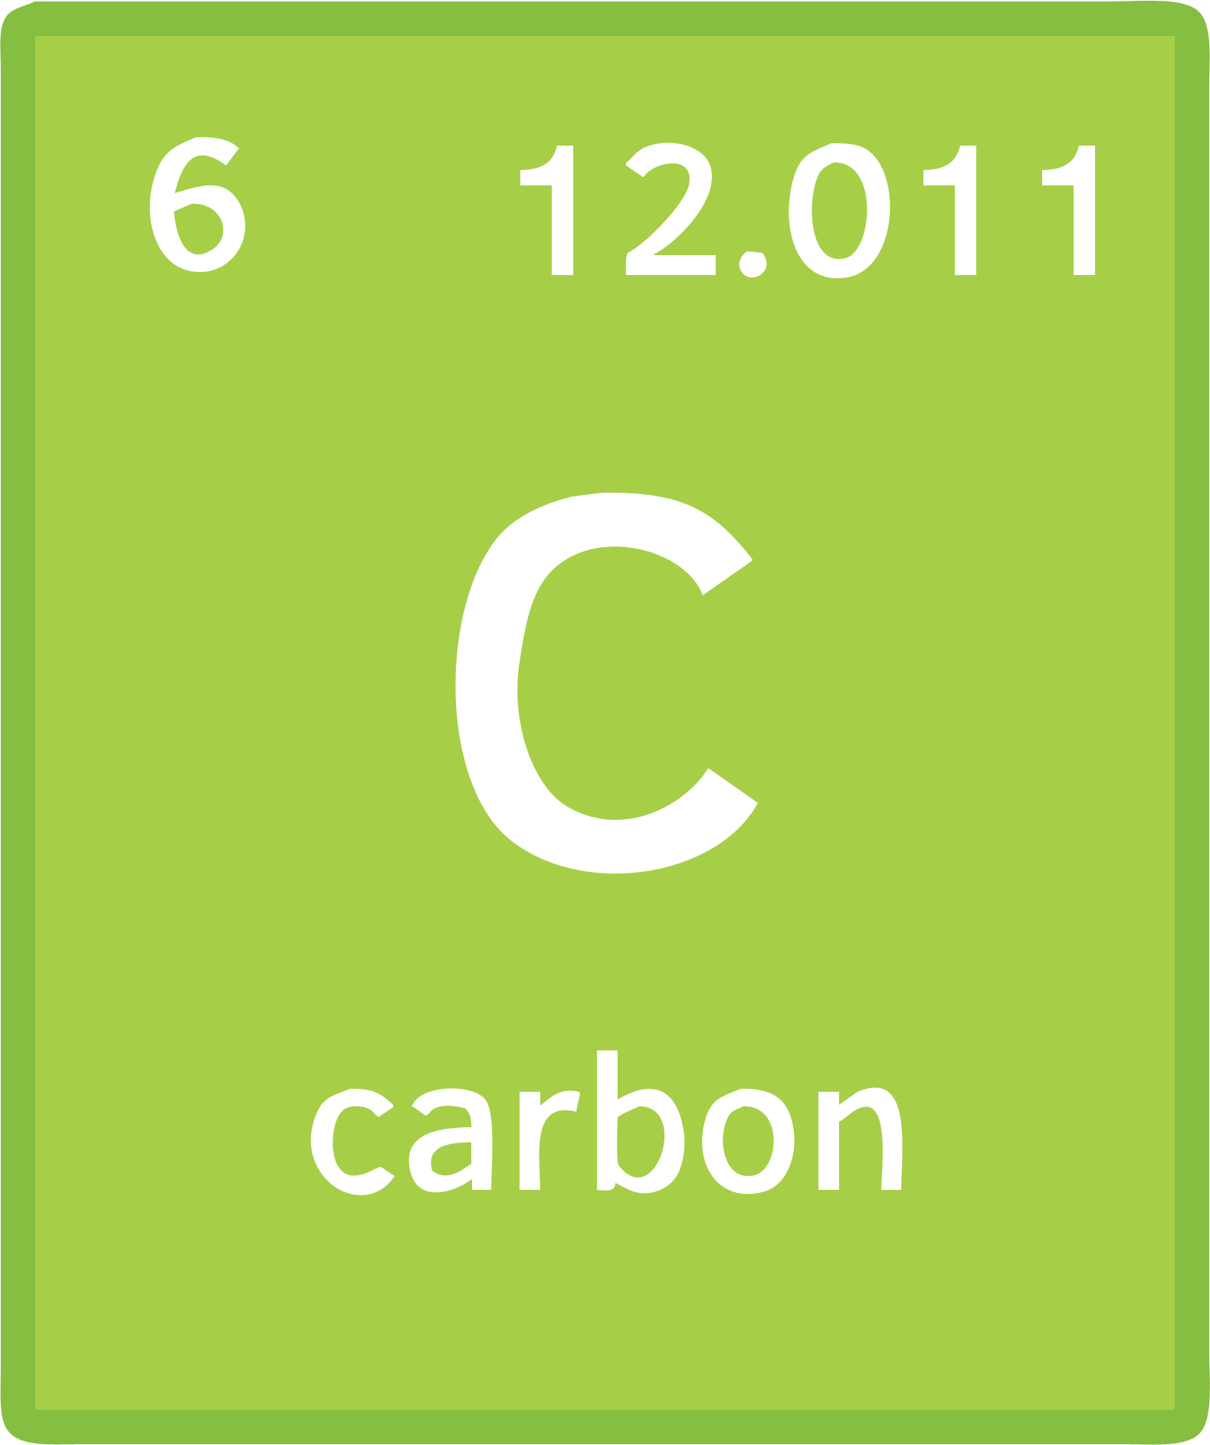
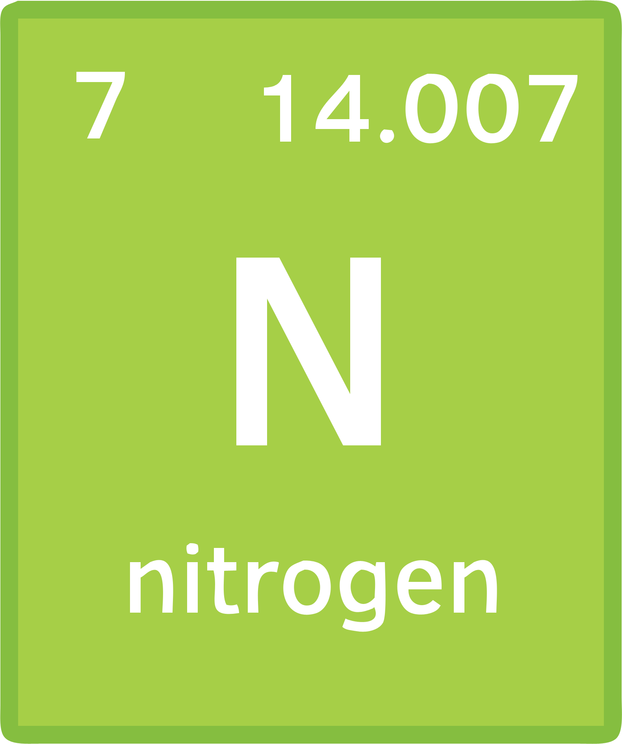
The First 20 Elements: How Many Can You Name? Answers
hydrogen H
helium He
lithium Li
beryllium Be
boron B
carbon C
nitrogen N
oxygen O
fluorine F
neon Ne
sodium Na
magnesium Mg
aluminium Al
silicon Si
phosphorous P
sulfur S
chlorine Cl
argon Ar
potassium K
calcium Ca

Slide 16

Isotopes
What do you notice about the isotopes of carbon?
Hint: Look at the mass numbers and atomic numbers.
Isotopes have the same atomic number and a different mass number.
Isotopes are different forms of the same element. They have the same number of protons and a different number of neutrons.

Slide 17
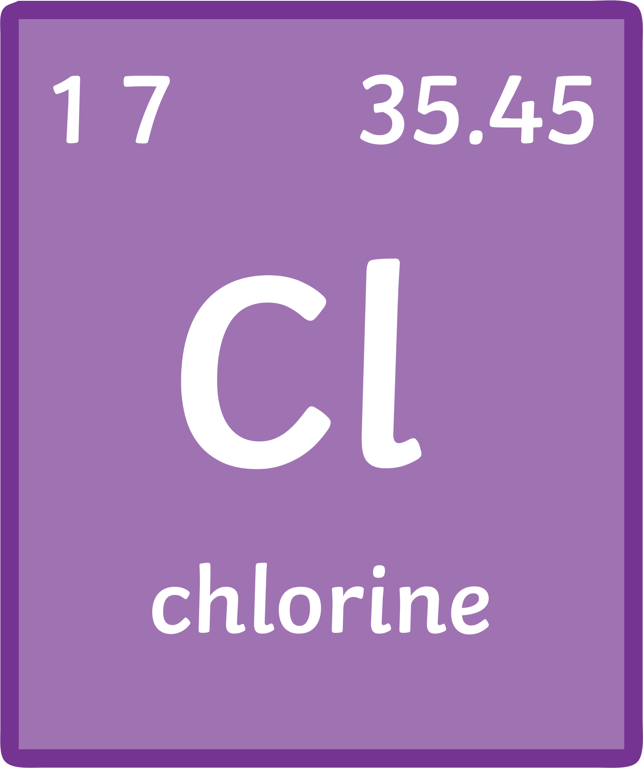
Isotopes
To calculate the relative atomic mass of an element, the following formula is used.
relative atomic mass (A_{r}) =
sum of (isotope abundance × isotope mass number)
sum of the abundance of all the isotopes
Example: Chlorine has two isotopes. Cl- 35 has an abundance of 75% and Cl- 37 has an abundance of 25%. Calculate the relative atomic mass of chlorine.
relative atomic mass =
Write a definition for the term isotope.
Keywords: atomic number, mass number, protons, neutrons.
(75 × 35) + (25 × 37)
75 + 25
2625 + 925
100
= 35.5

Slide 18

Quick Assessment
There are two isotopes of an element known as Z. Information about the isotopes is shown in the table below.
Use the information and the formula below to calculate the relative atomic mass of element Z.
Mass Number of Isotope | 12 | 14
% abundance | 60 | 40
relative atomic mass (A_{r}) =
sum of (isotope abundance × isotope mass number)
sum of the abundance of all the isotopes
(60 × 12) + (14 × 40)
60 + 40
Answer
720 + 560
100
= 12.8

Slide 19
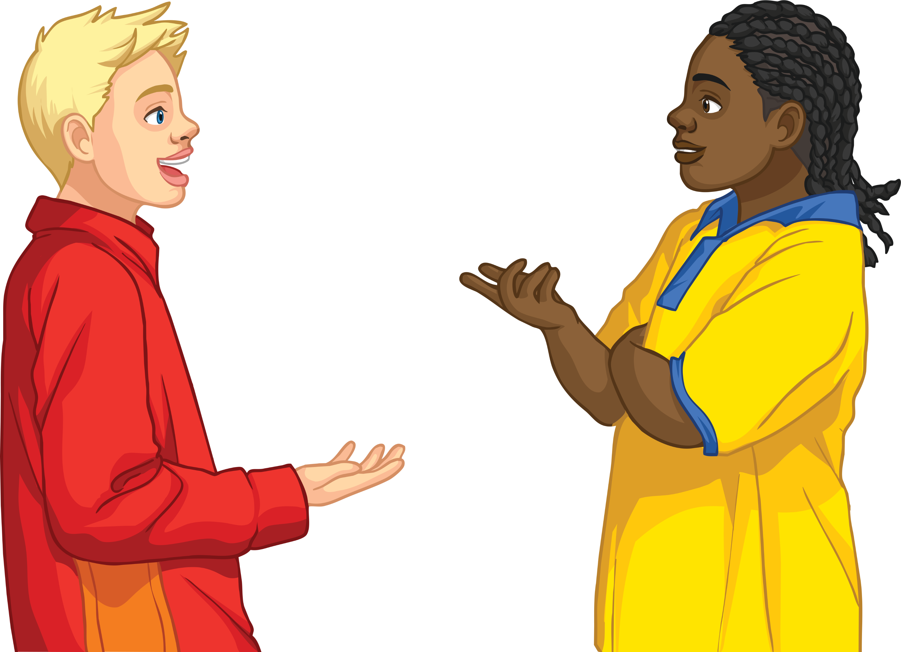
Plenary: Just a Minute
You have one minute to talk to your partner about the topic of atoms, elements and isotopes.
Your partner can challenge you if you repeat yourself, pause or make an incorrect statement.
They must then go on to complete the minute.
The winner is the last person talking.
Start

